Slide 1
Module-1 Section 1.1
HUMAN COMPUTER INTERACTION (HCI)…

Slide 2
Contents
Objective
Definition of HCI
What is HCI?
Human (User)
Computer (Communication)
Interaction (Technology)
Who are involved in HCI?
Sociology, Psychology, Ergonomics, Computer Science Engineers, Business, Graphic Designers, Ethnography, Technical Writing,…
Why HCI?
Cast study…

Slide 3
Objective
“Design interactive products / systems to support people in their everyday and working lives”

Slide 4
Definition
Human Computer Interaction is a discipline concerned with the design, evaluation and implementation of interactive computing for human use and with the study of major phenomena surrounding them”

Slide 5
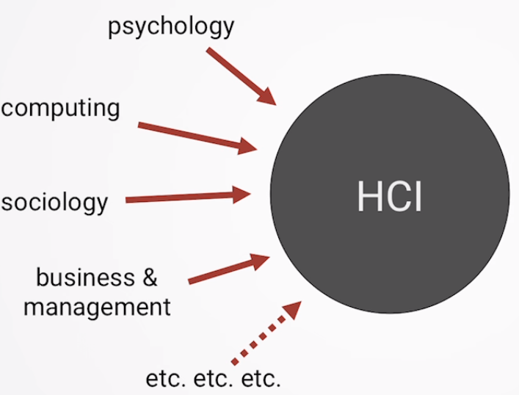
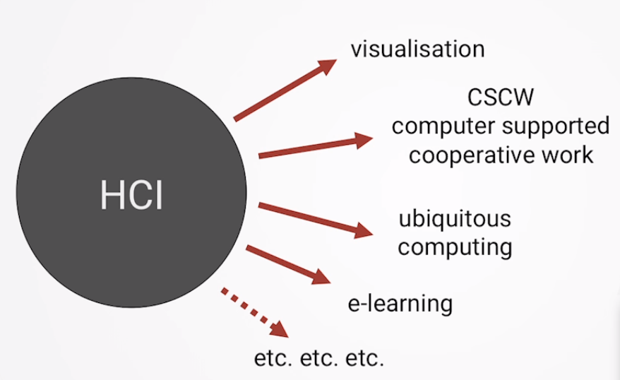
What is HCI? by Prof. Alan Dix
An academic discipline
Studying people interacting with (computer) technology
A design discipline
Designing interventions for systems involving people & technology
Many Roots
Psychology, computing, sociology, business & management, etc.,
Many Branches
Visualization, CSCW, Ubiquitous Computing, e-learning, etc.,
Design: 3 USE words
Useful (functional, does things)
Accomplish what is required: play music, cook dinner, format a document
Usable (easy to do things, does the right things, enjoyable, UX)
Do it easily and naturally, without danger of error, etc.,
Used ( attractive, available, acceptable to organization)
Make people want to use it, be attractive, engaging, fun, etc.,
Source: https://www.interaction-design.org/literature/topics/human-computer-interaction

Slide 6
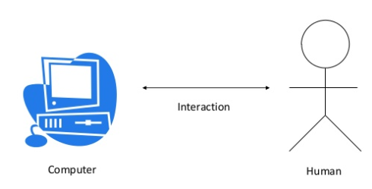

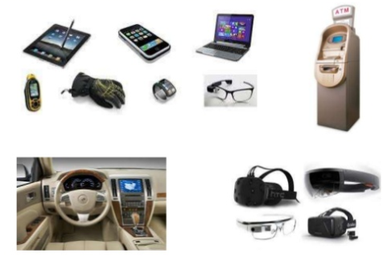

What is HCI?...
HUMAN (USER)
Don’t assume a person with a computer
Human ?? Or User
User is whoever trying to get the job done using the technology
Individual user/ group of user / sequence of users / range of users
COMPUTER (TECHNOLOGY)
Any technology ranging from desktop, mobile or embedded devices
INTERACTION (COMMUNICATION)
Direct (dialog with feedback, keyboard, mouse, haptic )
Indirect (batch processing or intelligent sensors controlling environment)
https://www.youtube.com/watch?v=oyjNqksc-m8

Slide 7
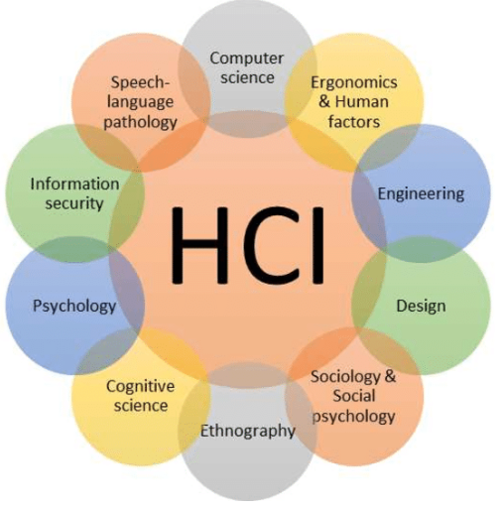
Who are involved in HCI?
Psychology & Cognitive Science
Give knowledge of User’s perceptual, cognitive and problem solving skills
Ethnography : Understand people with cultures and habits
Ergonomics
1949 – After World War-II Ergonomics Research Society
Process of designing and arranging workplaces, products and systems
Applies to design of anything that involves people-spaces, sports, health,..
Sociology
Understand wider context of interaction
Computer Science : able to build necessary technology
Business: market it
Graphics Design : Produce effective interface presentation
Technical Writing : To produce manuals
Not possible from 1 discipline in isolation

Slide 8
Why HCI?
In UI how do you feel if save and delete button nearby?
Do u need a confirmation before delete?
Car Driver and Interface Control for Music : Radio Knobs to increase volume / Tune
Can you a tell a robot to take care of kid for a while?

Slide 9
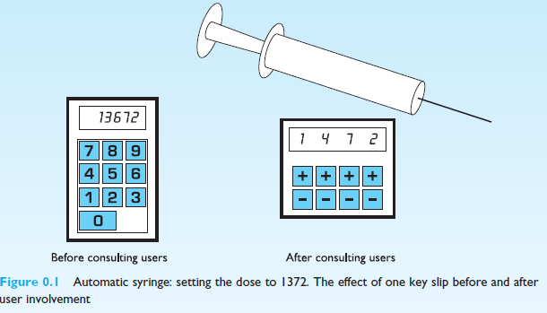
Case Study: Automatic Syringe
Case study: Automatic Syringe
A mechanical syringe was once being developed and prototype was demonstrated to hospital staff. Happily they quickly noticed the potential fatal flaw in its interface

